Slide 1
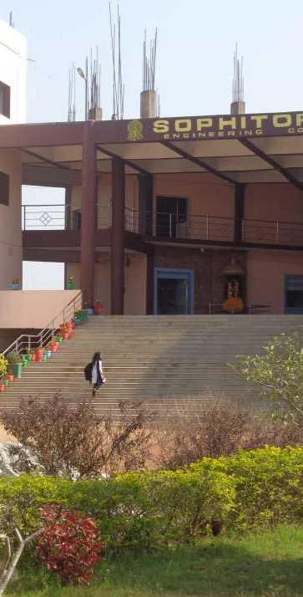
BRANCH -
CIVIL SEMESTER- 6TH
HYDROLOGY & IRRIGATION ENGG
DEPARTMENT OF CIVIL ENGINEERING
WRITTEN BY
ASST PROF. BARSHA BAISHALI JENA

Slide 2
Introduction
Hydrology may be defined as applied science concerned with water of the Earth in all its states, their occurrences, distribution and circulation through the unending hydrologic cycle of precipitation, consequent runoff, stream flow, infiltration and storage, eventual evaporation and re-precipitation.
Hydrology concerns itself with three forms of water –
Above land as atmospheric water or precipitation.
On land or surface as stored water or runoff
Below the land surface as ground water or percolation

Slide 3
The Importance of Hydrology is seen in
Design of Hydraulic Structures
Municipal and Industrial Water supply:
Irrigation
Hydroelectric Power Generation
Flood control in rivers
Navigation:
Pollution control

Slide 4
Hydrological Cycle
Water exists on the earth in gaseous form (water vapor), liquid and solid (ice) forms and is circulated among the different components of the Earth mainly by solar energy and planetary forces.
Sunlight evaporates sea water and this evaporated form is kept in circulation by gravitational forces of Earth and wind action. The different paths through which water in nature circulates and is transformed is called hydrological cycle.
Hydrological cycle is defined as the circulation of water from the sea to the land through the atmosphere back to the sea often with delays through process like precipitation, interception, runoff, infiltration, percolation, ground water storage, evaporation and transpiration also water that returns to the atmosphere without reaching the sea.

Slide 5
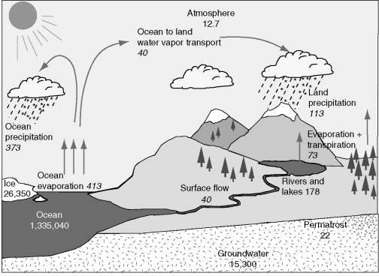

Slide 6
Catchment or Descriptive representation of hydrological cycle:
The hydrological cycle can also be represented in many different ways in diagrammatic forms as
i) Horton‘s Qualitative representation
ii) Horton‘s Engineering representation

Slide 7
:

Slide 8
Some important definitions
1. Precipitation- It is the return of atmospheric moisture to the ground in solid or liquid form. Solid form- snow, sleet, snow pellets, hailstones. Liquid form- drizzle, rainfall.
The following are the main characteristics of rainfall
a. Amount or quantity- The amount of rainfall is usually given as a depth over a specified area, assuming that all the rainfall accumulates over the surface and the unit for measuring amount of rainfall is cm.
The volume of rainfall = Area x Depth of Rainfall ( m3) The amount of rainfall occurring is measured with the help of rain gauges.

Slide 9
cont
b. Intensity- This is usually average of rainfall rate of rainfall during the special periods of a
c. Duration of Storm- In the case of a complex storm, we can divide it into a series of storms of different durations, during which the intensity is more or less uniform.
d. Aerial distribution- During a storm, the rainfall intensity or depth etc. will not be uniform over the entire area. Hence we must consider the variation over the area i.e. the aerial distribution of rainfall over which rainfall is uniform.

Slide 10
2.Infiltration- Infiltration is the passage of water across the soil surface.
The. vertical downward movement of water within the soil is known as percolation. The infiltration capacity is the maximum rate of infiltration for the given condition of the soil. Obviously the infiltration capacity decreases with time during/ after a storm.
Overland Flow- This is the part of precipitation which is flowing over the ground surface and is yet to reach a well-defined stream.
Surface runoff- When the overland flow enters a well-defined stream it is known as surface runoff (SRO).
Interflow for Sub surface flow- A part of the precipitation which has in-filtered the ground surface may flow within the soil but close to the surface. This is known as interflow. When the interflow enters a well- defined stream, then and only it is called run off.

Slide 11
Ground water flow-
This is the flow of water in the soil occurring below the ground water table. The ground water table is at the top level of the saturated zone within the soil and it is at atmospheric pressure. Hence it is also called phreatic surface.
A portion of water may enter a well-defined stream. Only then it is known as runoff or base flow. Hence we say that runoff is the portion of precipitation which enters a well-defined stream and has three components; namely- surface runoff, interflow runoff and ground water runoff or base flow.

Slide 12
Evaporation-
This is the process by which state of substance (water) is changed from liquid state to vapor form. Evaporation occurs constantly from water bodies, soil surface and even from vegetation. In short evaporation occurs when water is exposed to atmosphere (during sunlight). The rate of evaporation depends on the temperature and humidity

Slide 13
Transpiration
– This is the process by which the water extracted by the roots of the plants is lost to the atmosphere through the surface of leaves and branches by evaporation. Hence it is also known as evapotranspiration.

Slide 14
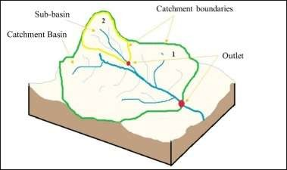
Water budget equation for a catchment
The area of land draining into a stream at a given location is known as catchment area or drainage area or drainage basin or water shed.

Slide 15
For a given catchment area in any interval of time, the continuity equation for water balance is given as-
(Change in mass storage)= (mass in flow) - (mass outflow) Δs = Vi – Vo
The water budget equation for a catchment considering all process for a time interval Δt is written as
Δs = P- R-G-E-T
Where,
Δs represents change in storage P- Precipitation
G- Net ground water flowing outside the catchment R- Surface runoff
E- evaporation

Slide 16
.
T- transpiration Storage of water in a catchment occurs in 3 different forms and it can be written as S= Ss +Sm +Sg
where
S- surface water storage, Sm- soil moisture storage Sg- ground water storage
Hence change in storage maybe expressed as
ΔS = ΔSs + ΔSm + ΔSg
The rainfall runoff relationship can be written as R= P – L
R- Surface runoff, P- Precipitation, L- Losses i.e. water not available to runoff due to infiltration, evaporation, transpiration and surface storage.

Slide 17
Precipitation
It is defined as the return of atmospheric moisture to the ground in the form of solids or liquids.
Forms of Precipitation:
Drizzle- This is a form of precipitation consisting of water droplets of diameter less than 0.05 cm with intensity less than 0.01cm/ hour.
2. Rainfall- This is a form of precipitation of water drops larger than 0.05cm diameter up to 0.5cm diameter. Water drops of size greater than 0.5 cm diameter tend to break up as they fall through the atmosphere. Intensity varies from 0.25 cm/ hour to 0.75cm/ hour.
3. Glaze- This is the ice coating formed when a drizzle or rainfall comes in contact with very old objects on the ground

Slide 18
.
Sleet- This occurs when rain drops fall through air which is below 00c. The grains are transparent, round with diameter between 0.1 cm to 0.4 cm.
Snow Pellets- These are white opaque round grains of ice. They are crystalline and rebound when falling onto the ground. The diameter varies from 0.05cm to 0.5cm.
Snow- This is precipitation in the form of ice crystals, usually a no. of ice crystals combining to form snowflakes.
Hails- These are balls or irregular lumps of ice of over 0.5cm diameter formed by repeated freezing and melting. These are formed by upward and downward movement of air masses in turbulent air currents.

Slide 21
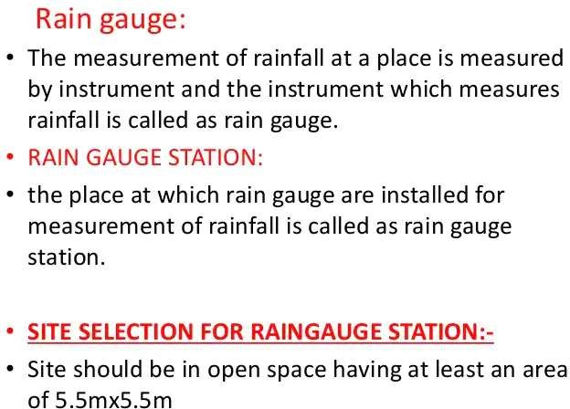

Slide 27
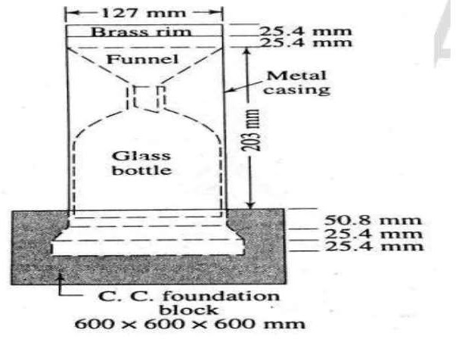

Slide 29
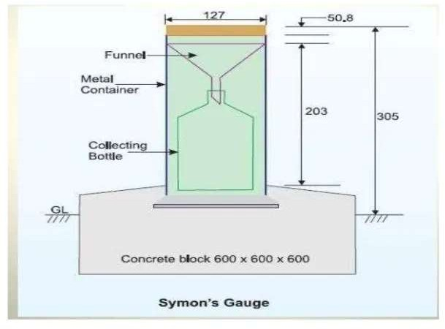

Slide 30
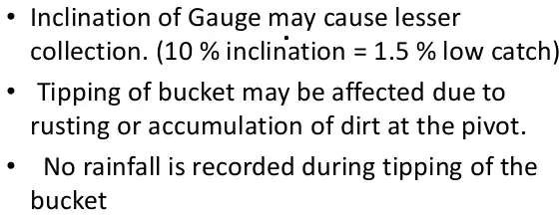

Slide 38
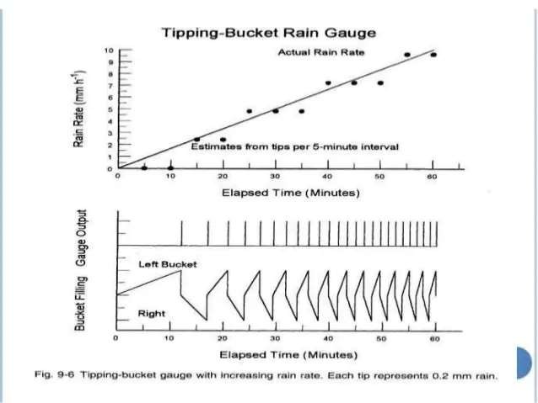

Slide 43
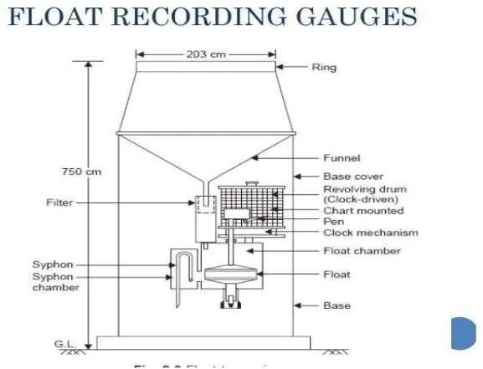

Slide 45
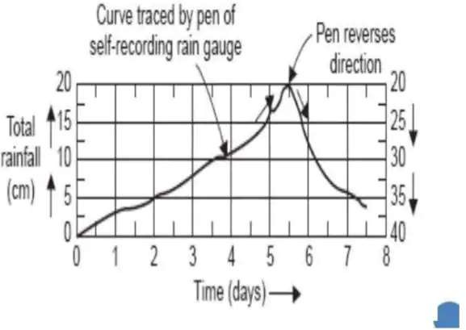

Slide 56
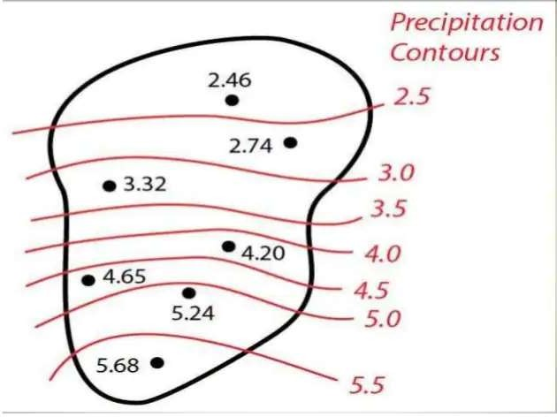

Slide 58
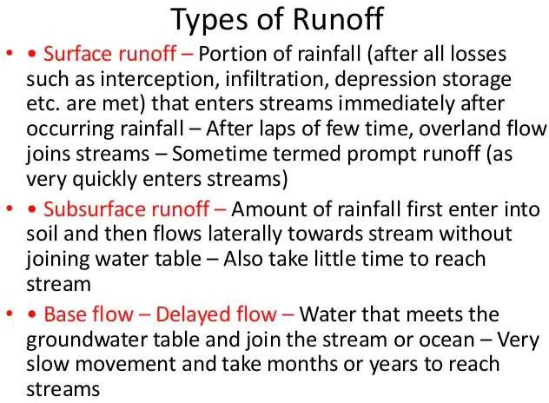

Slide 62
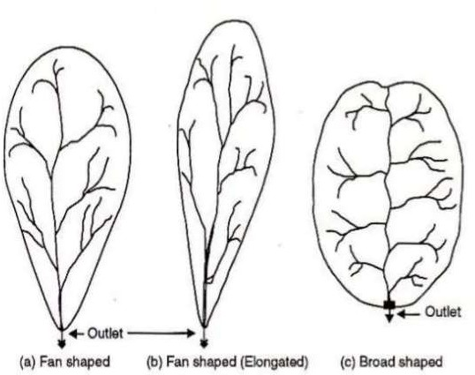

Slide 66
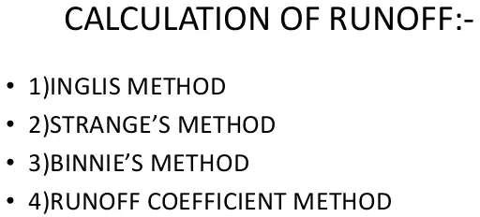

Slide 70
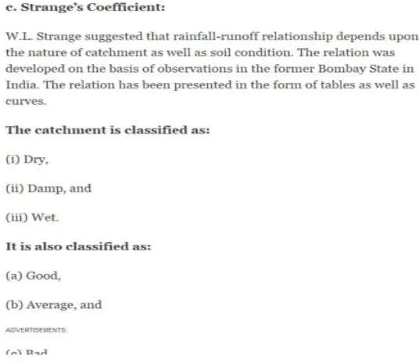

Slide 71
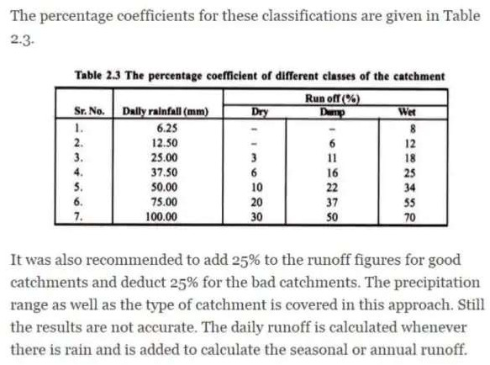

Slide 72
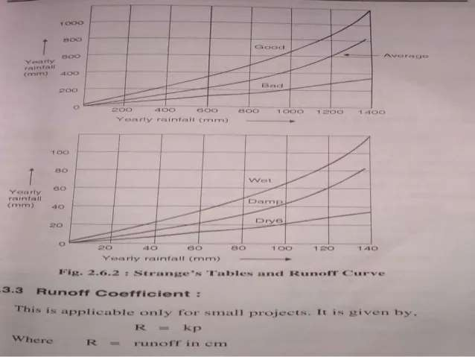

Slide 73
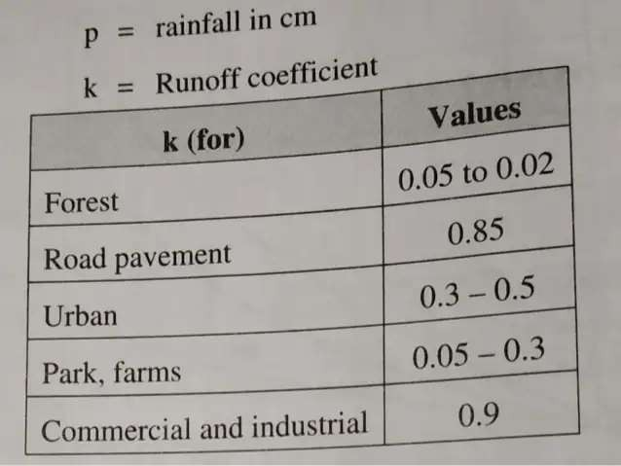

Slide 75
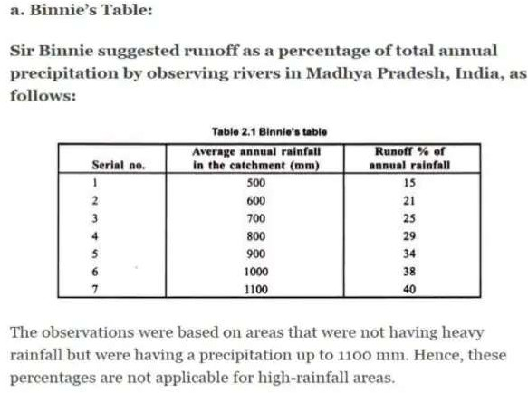

Slide 79
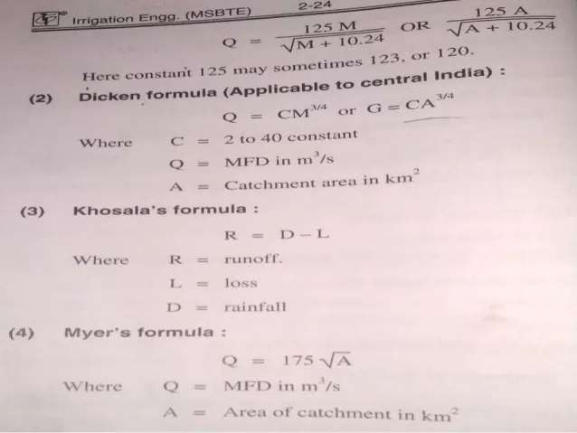

Slide 82
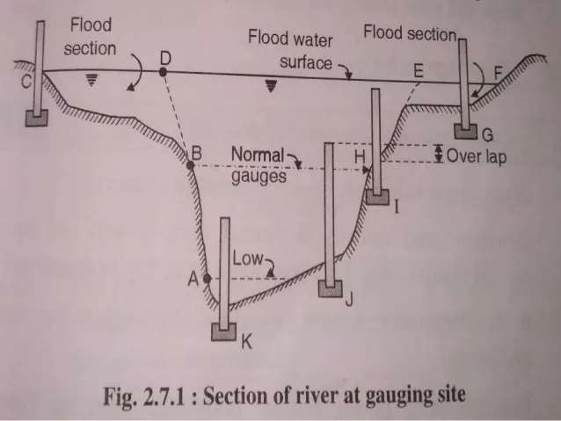

Slide 83
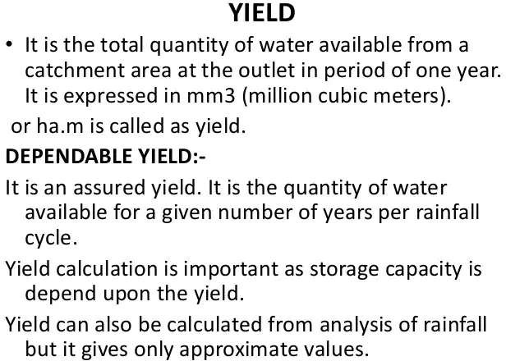

Slide 84
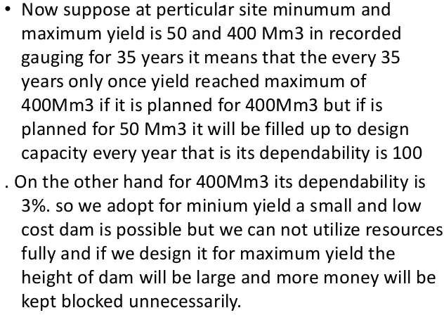

Slide 86
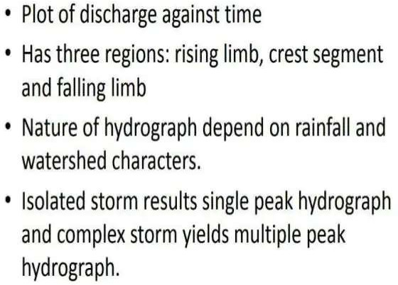

Slide 87
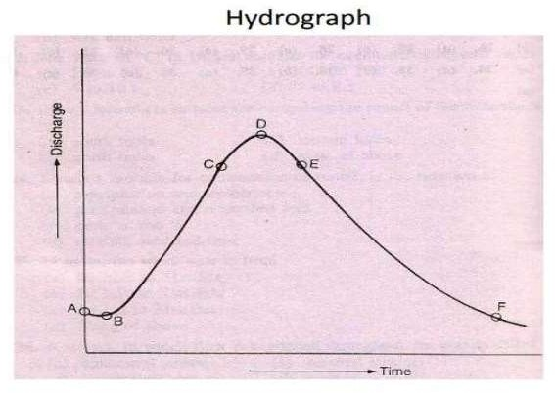

Slide 91
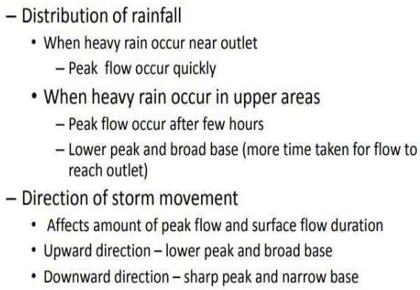

Slide 92
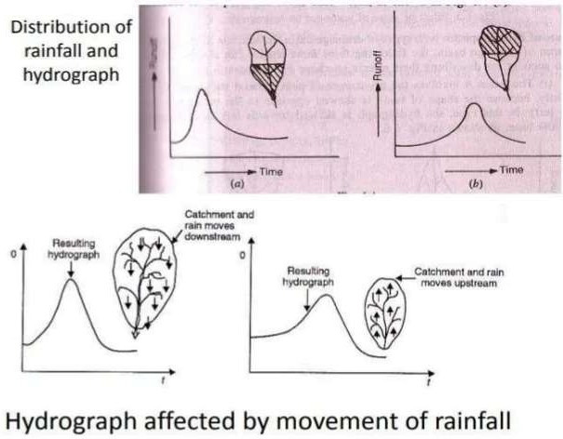

Slide 94
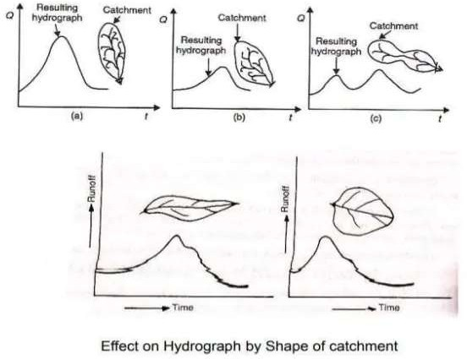

Slide 97
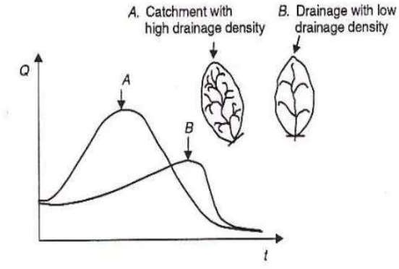

Slide 101
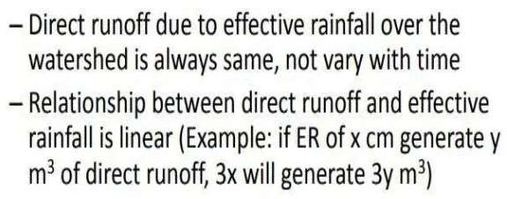

Slide 103
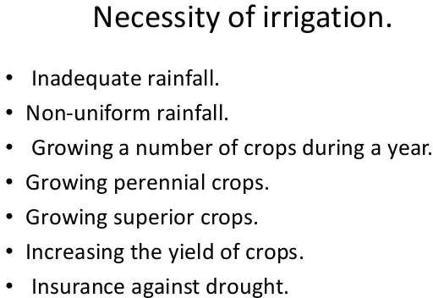

Slide 104
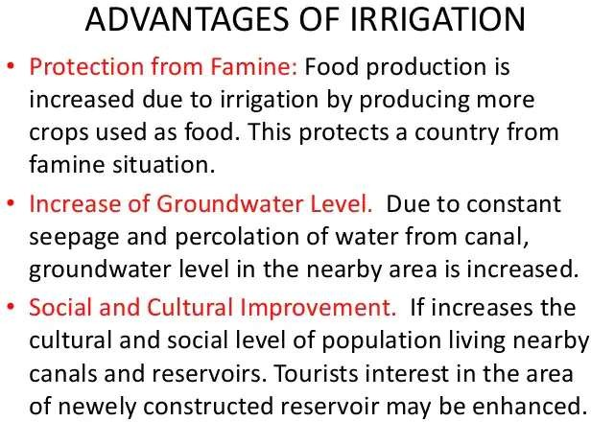

Slide 106
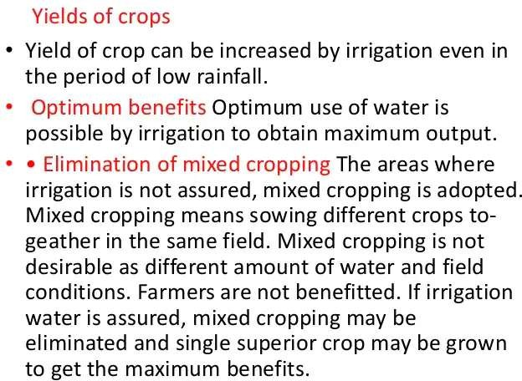

Slide 110
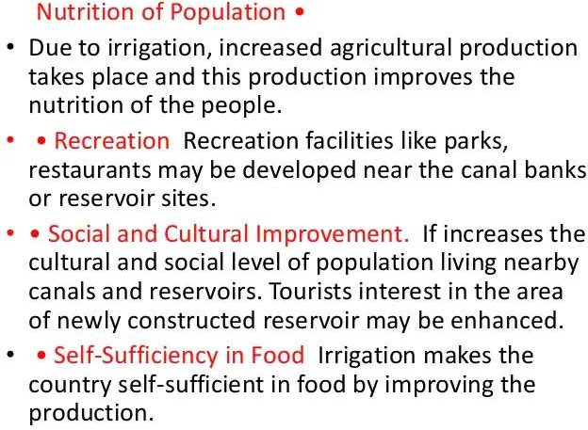

Slide 113
